Slide 1

Introduction
Visual Basic

Slide 2
Table OF contents
By the end of this lecture you will
Why learn this? It is not ”mechanical”!
All the LEGACY PROGRAMMING LANUGAGES
The Visual Basic Language
VB Download
Starting a project
Books

Slide 3
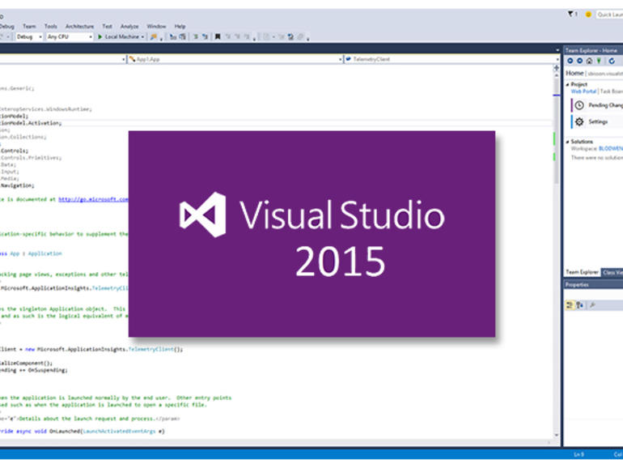
By the end of this lecture you will:
Be familiar with the learning, teaching and assessment methods for this module
Be aware of the comprehensive Learn Server resources and tutorials
Be familiar with the VB2015 IDE(s) and how to write your first program
Begin to understand how computers and computer programming works

Slide 4

Why learn this? It is not ”mechanical”!
Instrumentation and measurement (metrology) extremely important in ALL engineering disciplines
Modern mechanical systems typically integrates computing (inexpensive) for control/measurement
Commonly, control, monitoring, measurement and ‘virtual’ instrumentation applications
You will be introduced to Windows programming biased towards instrumentation applications for mechanical phenomenon
I will present a foundation in the field of current instrumentation and measurement practices

Slide 5
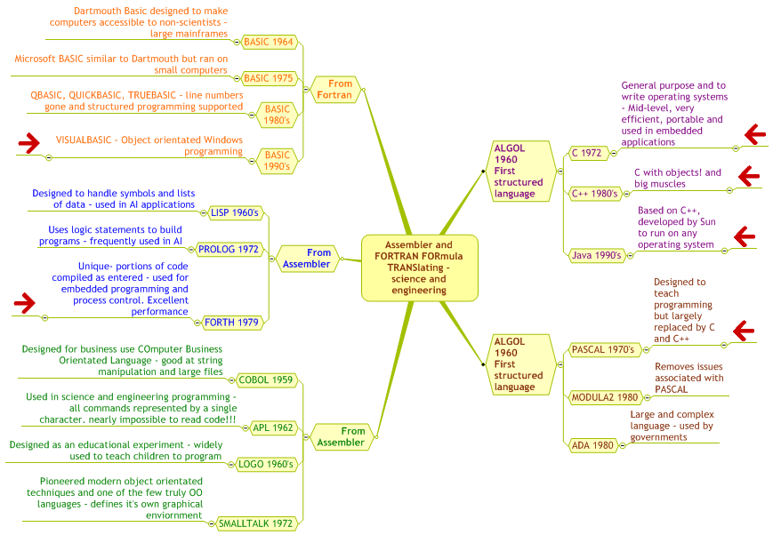
All the LEGACY PROGRAMMING LANUGAGES

Slide 6

The Visual Basic Language
The most used language – beginners language, but used by professionals
Early versions limited in power & flexibility
Modern Basics have removed limitations but
retained ease of use and added power
Familiar, understandable syntax
Not very standardised - machine specific (VB2022 = Windows only)

Slide 7
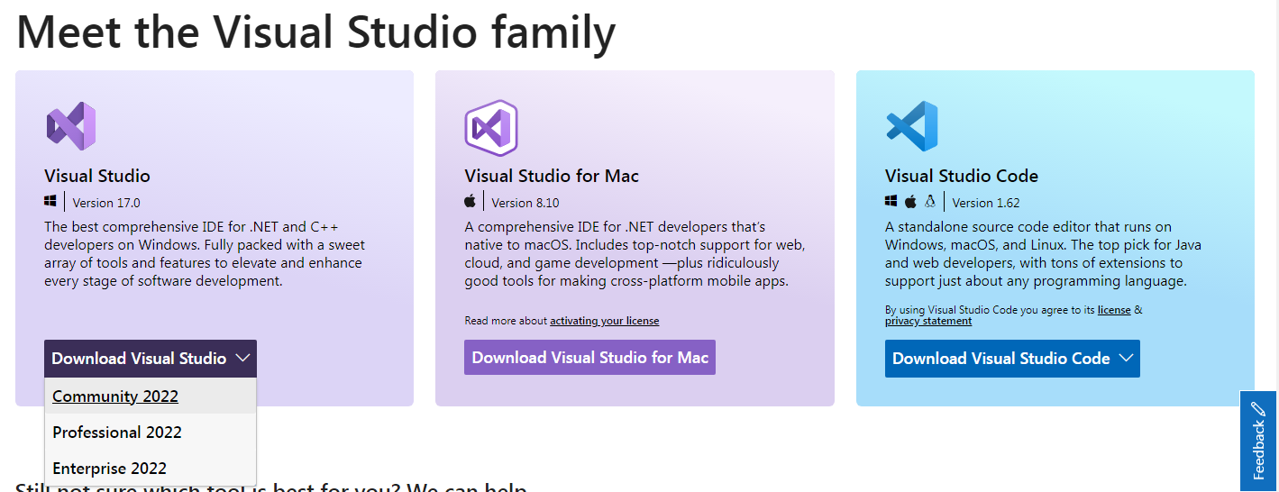
VB Download
https://visualstudio.microsoft.com/

Slide 8
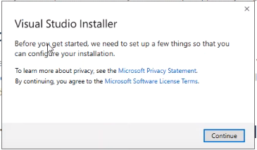
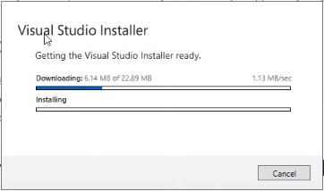
VB Download

Slide 9
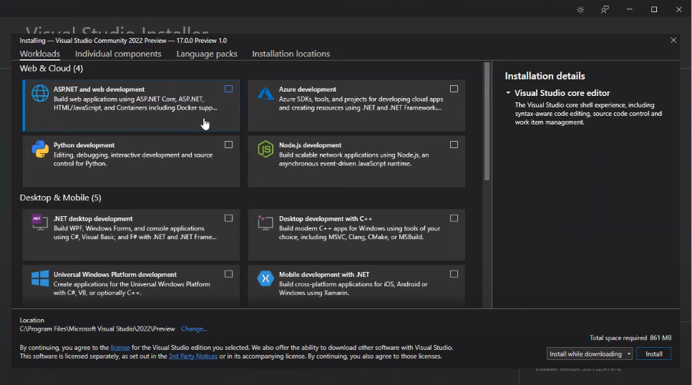

Slide 10
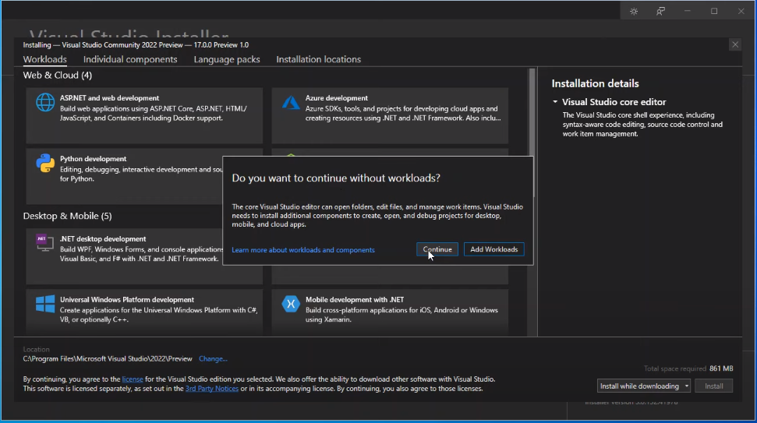

Slide 11
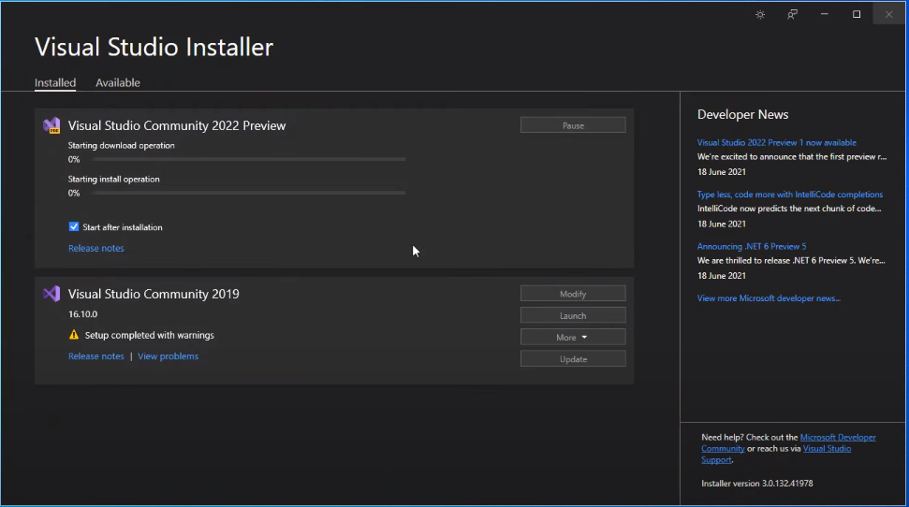

Slide 12
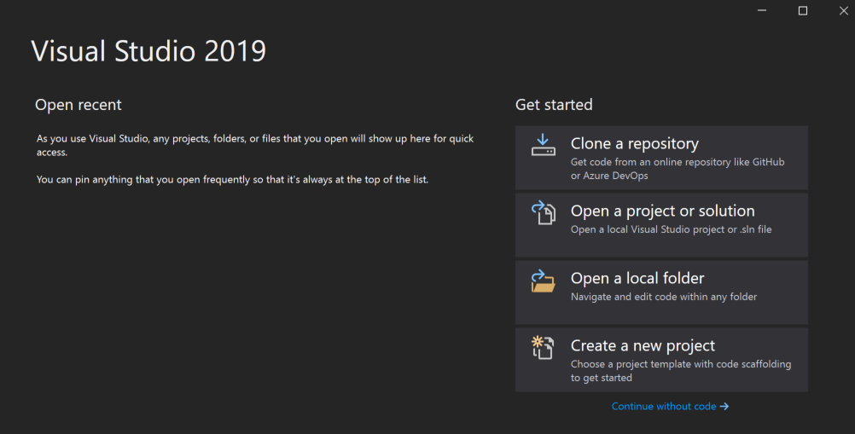
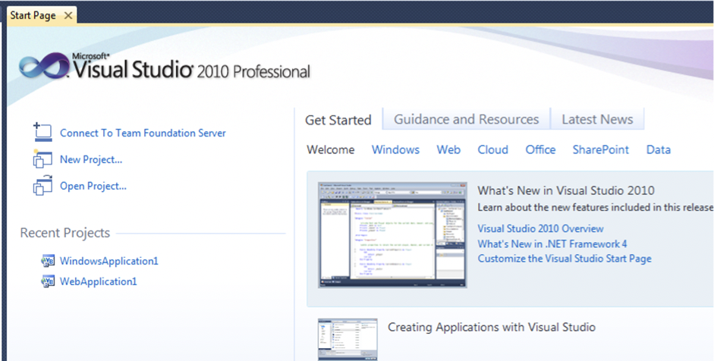
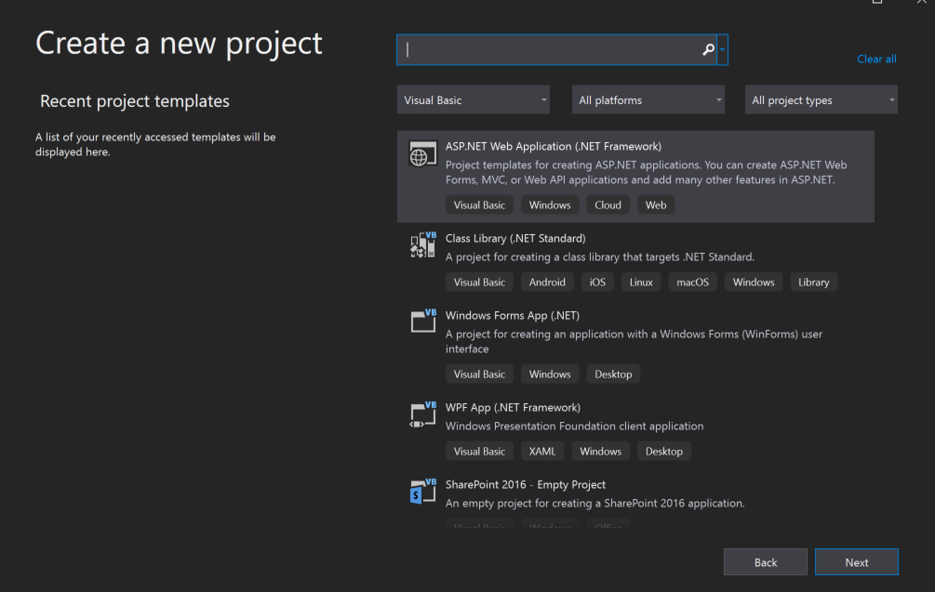
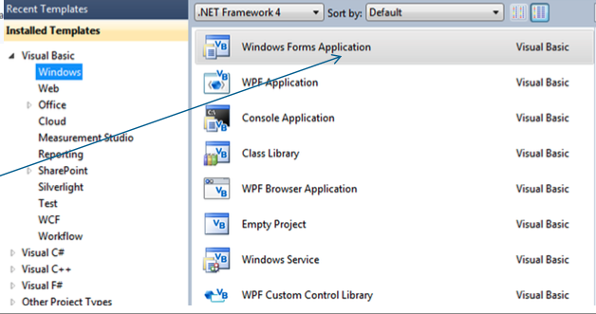
Starting a project

Slide 13
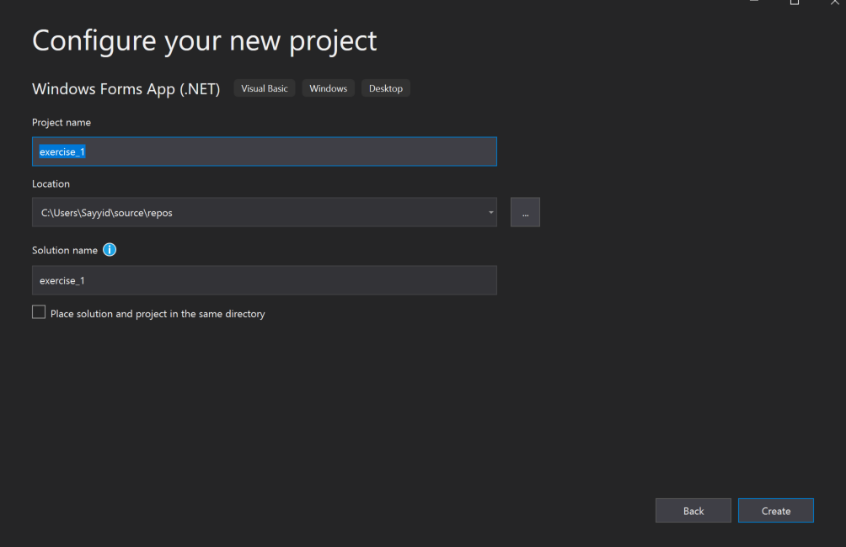
Starting a project
Write project name
Hit on the Enter button

Slide 14
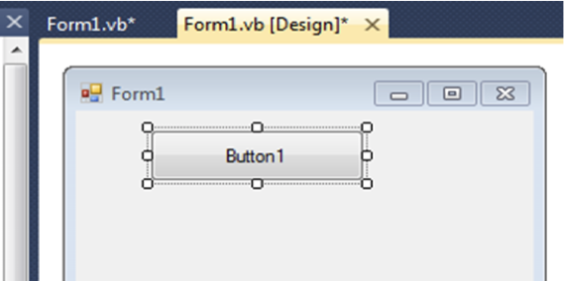
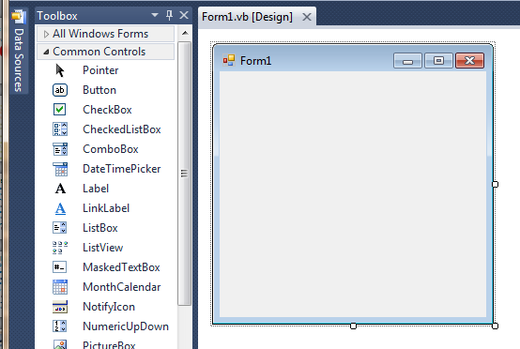
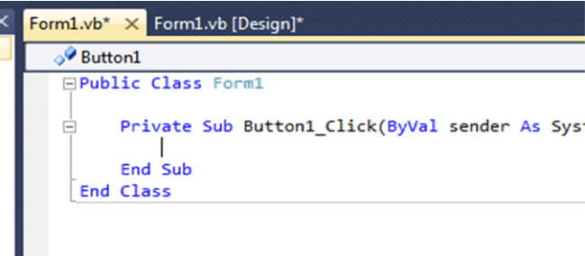
First time use – first program
Your new project screen shows the FORM where the CODE and COMPONENTS will reside
This is the INTERFACE design area
Place a Button on the Form – drag and draw!
2
1
DoubleclickButton to open CODE window, specifically, code for the Button
3
Notes:
Learn how to use the escape buttons to exit the selection, very important in UI design

Slide 15
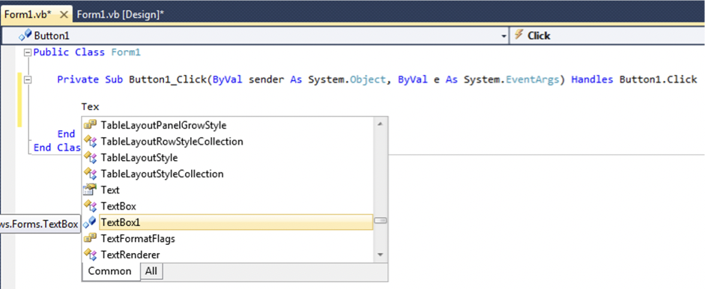
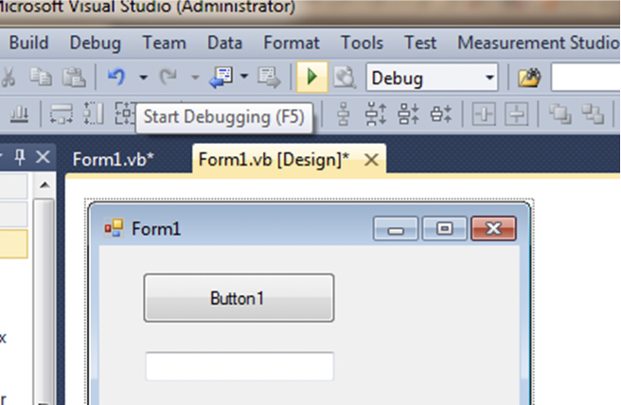
First time use – first program
VB will offer autocomplete options for words it recognises; Commands, Object names..
Scroll down and TAB or Click to avoid typing
Click triangular RUN (start debugging) button or
press F5 to run your program
1
2
*there is no need to write any code at this stage, mainly image on top is for example purposes.

Slide 16
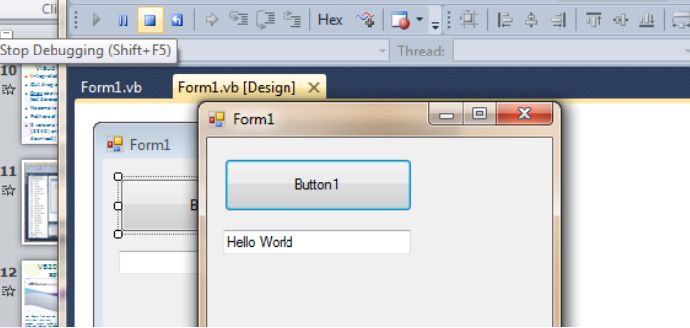
First time use – first program, It Works!
Stop using the square STOP button, Shift+F5, or the red cross, top right of your FORM
You can also stop the application by clicking the close button *red color button with an [x]

Slide 17
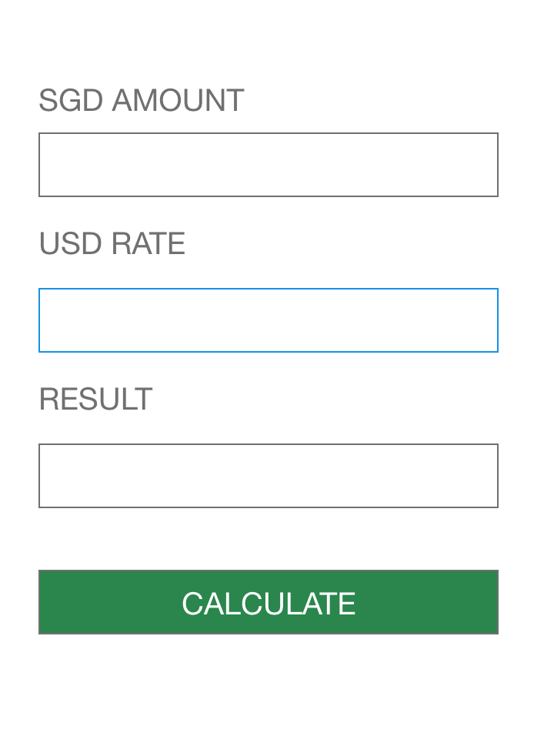
EXERCISE 1 - (10 – 15 MINS)
We are going to practice how to create a User interface.
Only UI is needed, we do not need to program the logic yet.
Get the experience to drag and drop your objects from the toolbox.

Slide 18
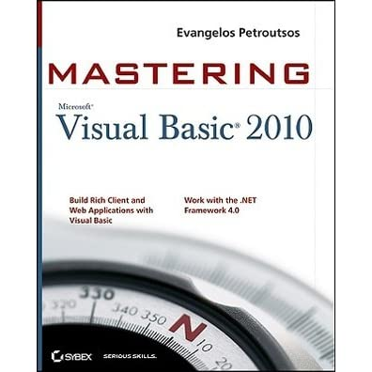
Books
Best VB2010 book I’ve seen Mastering Visual Basic 2010 by Evangelos Petroutsos.
1000+ pages, but don’t worry, we won’t cover them all! Loads in library: £25.99 from Amazon
Following this course should be sufficient to provide u the knowledge should you need to use this at work
Notes:
The book is mainly something extra, to help you to be the industry expert
- My recommendation, unless u need to use VBA in your work everyday, there is no need to be industry expert

